Slide 1
PAPER PRESENTATION · MATHEMATICS 2025, 13, 2313
Transformers and reinforcement learning
for the team orienteering problem under
dynamic conditions
Guerrero, Escoto, Ammouriova, Men and Juan — Universitat Politècnica de València
Jesús Inurria Porrero · Javier Salvatierra Corchado
Notes:
Paper: Guerrero et al., Mathematics 2025, 13, 2313. One-line pitch: a transformer trained with reinforcement learning builds routes for the team orienteering problem, and it keeps them feasible when travel times change. Fill in the name, course and date placeholders.

Slide 2
The team orienteering problem
Vehicle 1
Every stop carries a reward.
All vehicles leave from one depot and must reach the end depot.
Left out: no time
Each vehicle has a time budget, so some stops stay unvisited.
Depot
Maximise reward, not coverage.
Vehicle 2
Why it matters: last-mile delivery with electric vehicles, where battery range acts as the time budget.
NP-hard: the number of possible route sets explodes with the number of stops.
Notes:
Every stop gives a reward and the vehicles have a time budget, so we cannot visit everything: the goal is to maximise reward, not coverage. The paper motivates it with electric vehicles in last-mile delivery, where battery range limits the route. The problem is NP-hard.

Slide 3
Travel time is not a constant
f(i, j) = d(i, j) × (1 + 0.0625 · traffic + 0.0625 · weather)
d(i, j)
traffic
weather
The plain distance on the map.
Congestion, from 0 (clear) to 1 (jammed).
Rain, wind or snow, also 0 to 1.
Planned leg
Worst-case leg
+12.5%
Worst case, a leg takes 12.5% longer than the plan assumed.
A plan that fits exactly in the budget is therefore a plan that will break
Notes:
In the case study, the true travel time is the distance inflated by up to 12.5%, depending on traffic and weather (both between 0 and 1). If a route uses its whole budget on paper, any delay makes it infeasible, and an infeasible route scores zero.

Slide 4
Both methods loop. They loop at different moments.
Search — the VNS baseline
Learning — the RL model
Build a route
Break it apart
Put it back better
Try a route
Score the reward
Nudge the weights
for every new instance
on practice instances, before any real one
The loop runs while the courier waits: VNS found its best solution after 4.55 s on average (limit: 20 s).
The loop runs once, offline: about 40 hours for the dynamic models. Afterwards a plan takes 0.34 s (deterministic) to 0.54 s (dynamic, best variant).
The VNS baseline is the one published by Panadero et al. (2020)
Notes:
VNS searches from scratch for every new instance: it built, destroys and rebuilds routes, and on average it found its best solution after 4.55 s (limit 20 s). The RL model pays its cost once, offline: about 40 hours of training for each dynamic model. Then one plan takes 0.34 s for the best deterministic variant and 0.54 s for the best dynamic one.

Slide 5
Read the map once, then decide stop by stop
ONCE
per instance
The instance: stops, rewards, vehicle budgets
Embed: each stop and vehicle becomes a vector
Encode: attention relates every stop to the rest
EVERY
step of the route
Refresh the state: masked attention hides visited stops and finished vehicles
Build the context: where am I, how much time is left, what did I do before
Which stops can I reach and still get home? Pick one and move
until every vehicle is back at the end depot
The embeddings are fixed per instance. At each step only the visited-stop mask, the context and the list of allowed stops change.
Encoder–decoder transformer, as in Vaswani et al. and Kool et al.
Notes:
Correction to the first version: the initial embeddings are computed once, but the model recomputes a contextual embedding at every step with masked multi-head attention (visited stops and finished vehicles are masked). It then adds the current node, the remaining travel budget, the dynamic conditions and its own previous step, and finally applies a feasibility mask before choosing the next stop.

Slide 6
The idea that makes it work
A STOP IS OFFERED ONLY IF
cost to reach it + cost to get home from it ≤ time left
The way there is predicted
The way home is guessed high
A small network (an MLP) estimates what traffic and weather will cost on that exact segment.
Conditions later on cannot be known, so the plain distance is inflated by a learned worst-case factor.
One loss trains both: REINFORCE for the routing, mean squared error for the prediction, joined by a weight λ.
L = −(R(π) − b(s)) · log pθ(π | s) + λ · MSE
Feasibility is enforced by construction, not repaired afterwards
Notes:
A stop is only offered if going there plus getting home fits in the remaining budget. The way there uses the learned cost predictor; the way home cannot be known, so the deterministic distance is multiplied by a learned worst-case factor. Training uses REINFORCE with a baseline (built from augmented instances) plus an MSE term for the predictor, weighted by lambda.

Slide 7
Quality versus time, by variant
AVERAGE REWARD, HIGHER IS BETTER
SECONDS TO PRODUCE ONE PLAN
VNS
4.55 s
M
0.0014 s
M+
0.044 s
MO
0.07 s
MO+
0.34 s
Axis starts at 10
MO+ is about 4% better than VNS and 13× faster. M matches VNS in over 3,000× less time.
M: base model · M+: with reflections · MO: with rotations · MO+: both (256 versions of each instance). Deterministic problem, 15–45 stops, 2–4 vehicles.
Notes:
Numbers are the deterministic problem (Table 1 and Section 6.1). The paper names the variants M+/MO+ in the text and MA/MR/MRA in the tables; here M+ = reflections, MO = rotations, MO+ = both. The 13x comes from MO+ (0.34 s) against the VNS mean time to its best solution (4.55 s). The base model M already ties VNS at 0.0014 s.

Slide 8
Generalisation, and where each method wins
ONE MODEL, TRAINED ON 18–36 STOPS AND 2–4 VEHICLES, TESTED UP TO 45 STOPS WITHOUT RETRAINING
seen in training
unseen: +9 stops
15
18
36
45
number of stops
REWARD ADVANTAGE OF RL (MO+) OVER VNS
VNS catches up as stops grow
It gets its best result at 45 stops and 2 vehicles.
More time barely helps VNS
Giving VNS 3 min instead of 20 s improved it by only ~0.2% (35 stops).
+0.18
+0.47
+0.69
2 vehicles
3 vehicles
4 vehicles
Average reward on the deterministic instances; VNS limited to 20 s per instance
Notes:
The abstract's main claim is generalisation: a single model trained on 18 to 36 stops and 2 to 4 vehicles is evaluated up to 45 stops with no retraining, and quality does not fall off sharply. Per fleet size, the RL advantage over VNS grows with vehicles (0.18, 0.47, 0.69). VNS improves as the number of stops grows and is best at 45 stops with 2 vehicles. The authors read this as RL scaling better with fleet size and VNS being stronger in dense contexts.

Slide 9
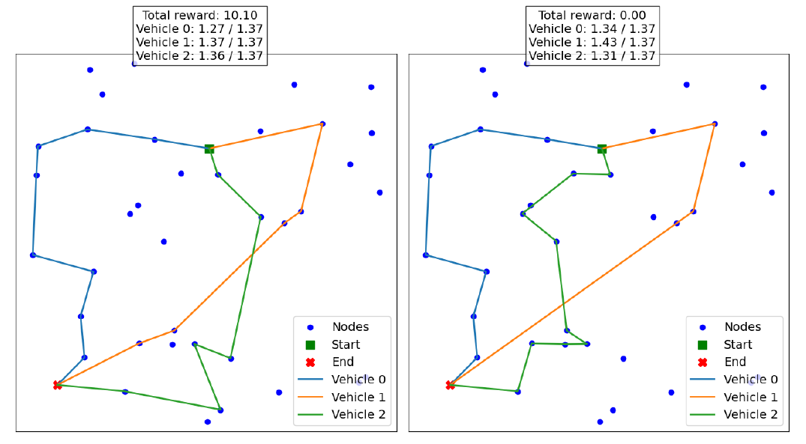
When travel times change
AVERAGE REWARD, DYNAMIC SCENARIO
No prediction module vs. best dynamic model
2.54 is not bad routing. A vehicle that arrives late has its route thrown out, and it scores nothing.
Same model, same instance. Left: no delays, reward 10.10. Right: with delays, vehicle 1 needs 1.43 of a 1.37 budget, so the reward drops to 0.00.
The dynamic models broke the limit zero times.
Figure 5 from Guerrero et al. (2025), CC BY 4.0
27,000 synthetic instances · 15–45 stops · 2–4 vehicles
Notes:
In the dynamic scenario the deterministic model M has the same architecture but no prediction module, and its average reward is 2.54 because many routes exceed the vehicle limit and score zero (the more vehicles, the worse: 3.45, 2.32, 1.86). The dynamic models never broke the limit and reach 11.26 with reflections and rotations, close to the deterministic case. Figure 5: the same model and instance give 10.10 without delays and 0.00 with them.

Slide 10
TAKEAWAY · OUR READING OF THE RESULTS
Modelling the uncertainty mattered more than solving the problem better.
WORTH ASKING ABOUT
Training and test instances come from the same uniform distribution.
About 40 hours of training for each dynamic model, and more resources as instances grow.
No re-optimisation once a vehicle is on the road, and no stochastic travel times yet.
NEXT STEPS IN THE PAPER
Stochastic conditions: probabilistic travel times and fluctuating customer availability.
A hybrid with metaheuristics such as VNS, combining global search with RL's speed.
Thank you — questions?
Notes:
The headline is our interpretation, not a quote from the paper: the dynamic model's gain over the deterministic one (11.26 vs 2.54) is far larger than the gains from better solution methods. Limits: same distribution for training and testing, about 40 h of training, and no re-optimisation during execution. Future work in the paper: stochastic travel times and hybridisation with metaheuristics.

Slide 11
BACKUP
Mathematical formulation
Objective
max Σv Σi,j xijv · rj
collect as much reward as possible
Depots
Σj xojv ≤ 1 · no arc enters o or leaves d
each vehicle leaves o at most once and ends at d
Visits
Σv Σi xijv ≤ 1
each stop is visited at most once across all vehicles
Routes
flow conservation + MTZ ordering variables
continuous routes without subtours
Time budget
Σi,j xijv · f(i, j) ≤ Lv
each vehicle stays within its limit
f(i, j) = dij · (1 + α · tij + β · eij), predicted before optimising. Costs are assumed known or estimated at optimisation time; no re-optimisation during execution.
Notes:
Backup: constraints (1)-(11) of Section 3, grouped. Objective (1); depot constraints (2)-(5); at-most-once visits (6); flow conservation (7); MTZ subtour elimination (8),(10); time budget (9); binary variables (11).

Slide 12
BACKUP
How the instances are generated
[0, 1]²
U[0, 1]
d(o, d) + 0.5 + U[0, 1.5]
15–45 · 2–4
Nodes placed uniformly at random in the unit square
Reward of each node, drawn uniformly at random
Distance budget of each vehicle: feasible, but never trivial
Stops · vehicles. 600 instances per combination (300 deterministic and their dynamic versions)
Dynamic version: the true travel time is the distance inflated by up to 12.5%, with traffic and weather each between 0 (ideal) and 1 (most adverse).
Section 4 of the paper. The abstract and experiments use 27,000 instances; Section 4 mentions 54,000 generated.
Notes:
Backup: instance generation from Section 4. Note the paper says 54,000 instances were generated in Section 4, while the abstract and the results refer to 27,000 instances; the deck uses 27,000.

Slide 13
BACKUP
Training and decoding details
Training
Decoding at inference
REINFORCE with a baseline built from augmented instances (Lee and Ahn)
2,700 optimisation steps per epoch, batch of 256
Each epoch is evaluated on 110,000 instances; a new best model is kept only if a t-test (0.05) confirms it
One model for 18–36 stops and 2–4 vehicles, each configuration sampled equally
Adam, learning rate decayed, then sampled around the best rate
RTX 4060 GPU, 16 GB of RAM; about 40 h per dynamic model
M: greedy decoding, the most probable stop at each step
M+: also solves 8 reflections of the instance and keeps the best
MO: also solves 32 rotations of the instance and keeps the best
MO+: reflections × rotations = 256 versions of each instance
Mean time per plan. Deterministic: 0.0014 s, 0.044 s, 0.07 s, 0.34 s. Dynamic: 0.0022 s, 0.052 s, 0.095 s, 0.54 s.
Notes:
Backup: Sections 5.1 to 5.3. Reflections and rotations preserve distances in the unit square, so every version is a valid instance of the same problem.

